Slide 1
FP-growth Algorithm
Use a compressed representation of the database using an FP-tree
Once an FP-tree has been constructed, it uses a recursive divide-and-conquer approach to mine the frequent itemsets

Slide 2
FP-growth Algorithm
An FP-tree is a compressed representation of the input data. It is constructed by reading the data set one transaction at a time and mapping each transaction onto a path in the FP-tree.

Slide 3
FP growth algorithm
As different transactions can have several items in common, their paths may overlap. The more the paths overlap with one another, the more compression we can achieve using the FP-tree structure. If the size of the FP-tree is small enough to fit into main memory, this will allow us to extract frequent itemsets directly from the structure in memory instead of making repeated passes over the data stored on disk.

Slide 4
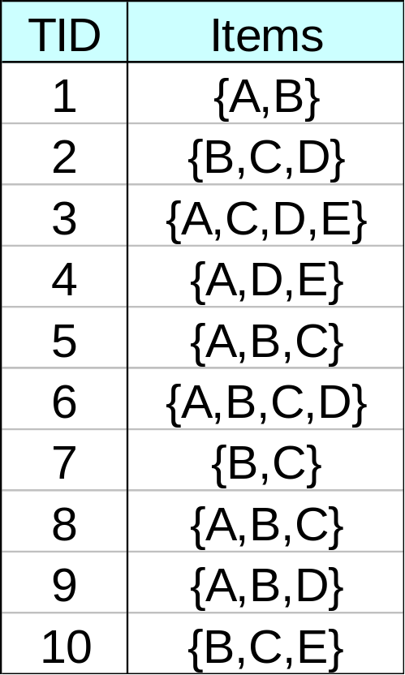
FP-tree construction
null
After reading TID=1:
A:1
B:1
After reading TID=2:
null
A:1
B:1
B:1
C:1
D:1

Slide 5
FP-tree construction
null
After reading TID=1:
A:1
B:1
After reading TID=2:
null
A:1
B:1
B:1
C:1
D:1

Slide 6
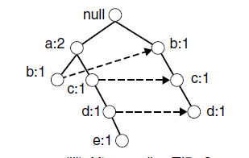
FP-tree construction

Slide 7
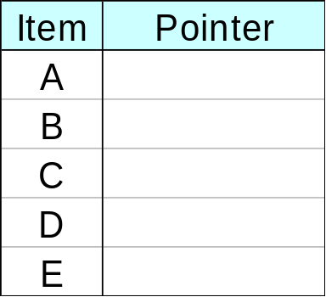
FP-Tree Construction
Transaction Database
null
A:7
B:3
B:5
C:3
C:1
D:1
Header table
D:1
C:3
E:1
D:1
E:1
D:1
E:1
D:1
Pointers are used to assist frequent itemset generation
Notes:
In the best-case scenario, where all the transactions have the
same set of items, the FP-tree contains only a single branch of nodes. The
worst-case scenario happens when every transaction has a unique set of items.

Slide 8
FP-growth
null
Conditional Pattern base for D:
P = {(A:1,B:1,C:1),
(A:1,B:1),
(A:1,C:1),
(A:1),
(B:1,C:1)}
Recursively apply FP-growth on P
Frequent Itemsets found (with sup > 1):
AD, BD, CD, ACD, BCD
A:7
B:1
B:5
C:1
C:1
D:1
C:3
D:1
D:1
D:1
D:1

Slide 9
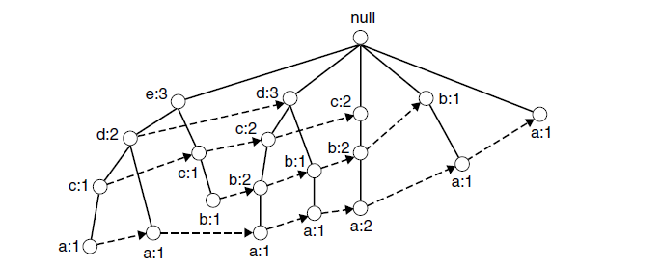
Size of FP Tree
The size of an FP-tree also depends on how the items are ordered. If the ordering scheme in the preceding example is reversed, i.e., from lowest to highest support item.
Notes:
The tree appears to be denser because the branching factor at the root node has increased from 2 to 5 and the number of nodes containing the high support items such as a and b has increased from 3 to 12.

Slide 10
Frequent Itemset generation
FP-growth is an algorithm that generates frequent itemsets from an FP-tree by exploring the tree in a bottom-up fashion. The algorithm looks for frequent itemsets ending in e first, followed by d, c, b, and finally, a.
Notes:
The tree appears to be denser because the branching factor at the root node has increased from 2 to 5 and the number of nodes containing the high support items such as a and b has increased from 3 to 12.

Slide 11
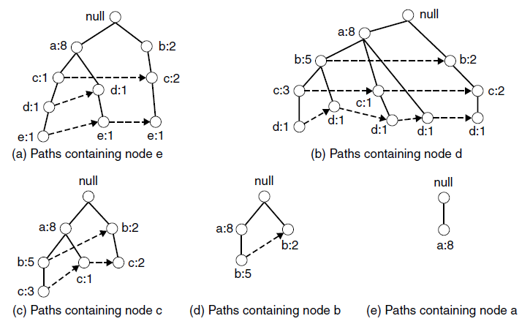
FP growth path

Slide 12
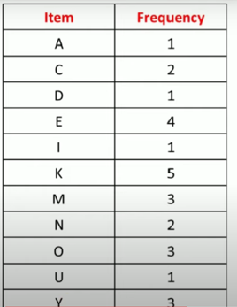
Example
Support Count = 3

Slide 13
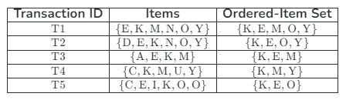
Ordered Itemset

Slide 14
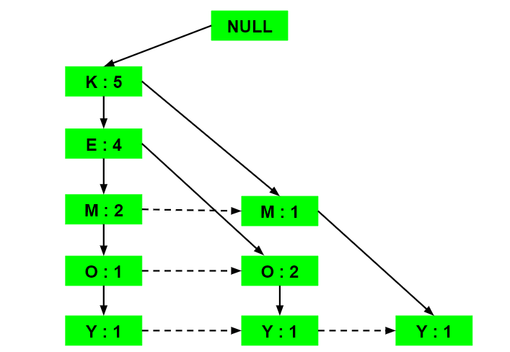
FP TREE

Slide 15
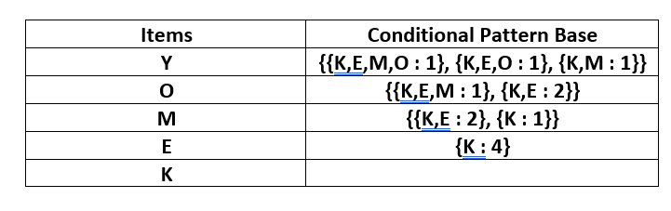
Conditional Pattern Base

Slide 16
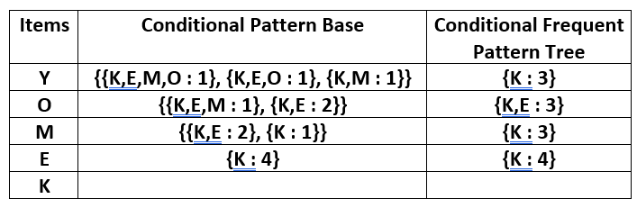
Conditional Frequent Pattern Tree

Slide 17
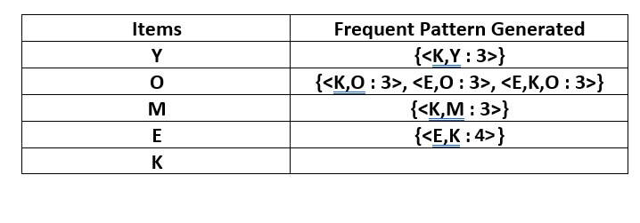
Frequent Pattern Generated
Notes:
For each row, two types of association rules can be inferred for example for the first row which contains the element, the rules K -> Y and Y -> K can be inferred. To determine the valid rule, the confidence of both the rules is calculated and the one with confidence greater than or equal to the minimum confidence value is retained.

Slide 18
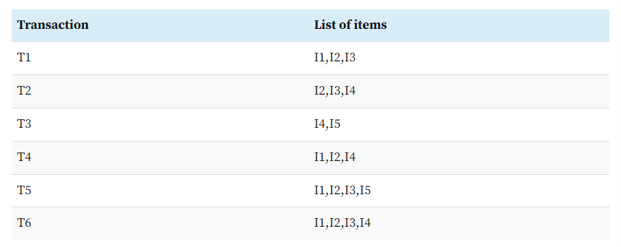
Example2

Slide 19
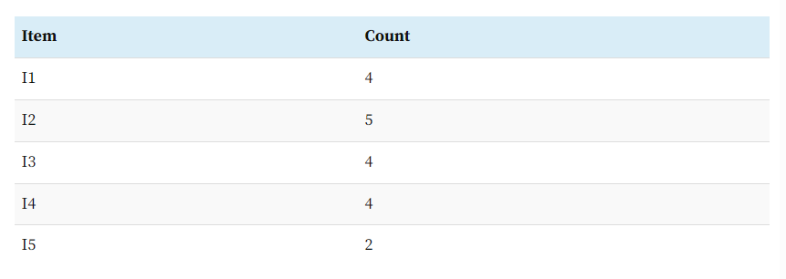
Support Count

Slide 20
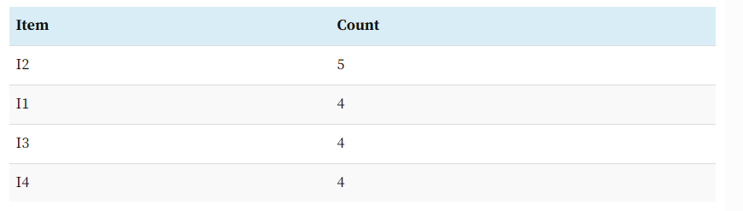
Newly Ordered

Slide 21
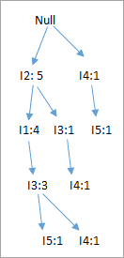
FP Tree

Slide 22
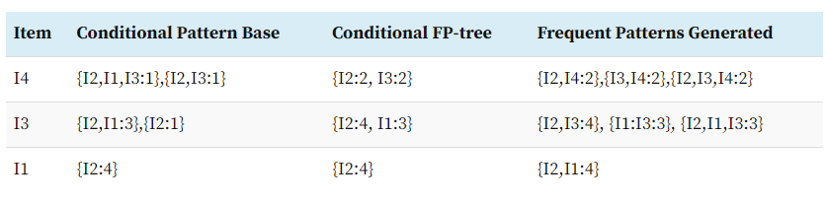
Frequent Pattern

Slide 23
ECLAT
The ECLAT algorithm stands for Equivalence Class Clustering and bottom-up Lattice Traversal. It is one of the popular methods of Association Rule mining

Slide 24
ECLAT
The basic idea is to use Transaction Id Sets(tidsets) intersections to compute the support value of a candidate and avoiding the generation of subsets which do not exist in the prefix tree. In the first call of the function, all single items are used along with their tidsets. Then the function is called recursively and in each recursive call, each item-tidset pair is verified and combined with other item-tidset pairs.

Slide 25
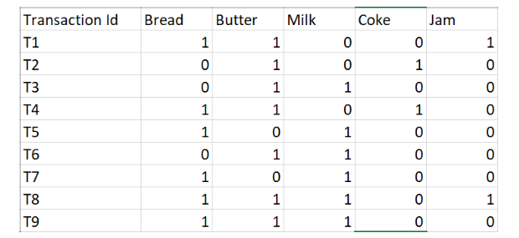
ECLAT Example

Slide 26
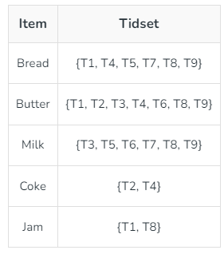
ECLAT Example Continued
Notes:
K = 1, minsup = 2

Slide 27
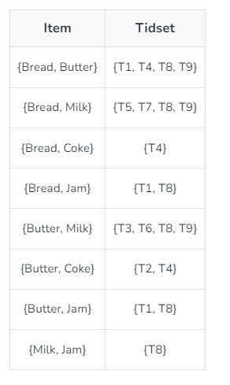
ECLAT Example Continued
Notes:
K = 1, minsup = 2

Slide 28
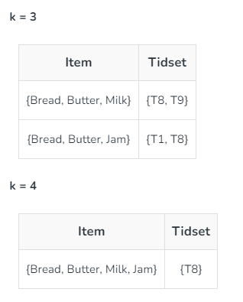
ECLAT Example Continued
Notes:
K = 1, minsup = 2

Slide 29
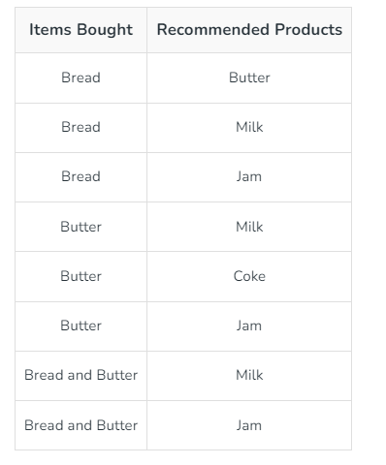
ECLAT Example Continued
Notes:
Memory Requirements: Since the ECLAT algorithm uses a Depth-First Search approach, it uses less memory than Apriori algorithm.
Speed: The ECLAT algorithm is typically faster than the Apriori algorithm.
Number of Computations: The ECLAT algorithm does not involve the repeated scanning of the data to compute the individual support values.

Slide 30
Rule Generation
Given a frequent itemset L, find all non-empty subsets f ⊂ L such that f → L – f satisfies the minimum confidence requirement
  If {A,B,C,D} is a frequent itemset, candidate rules:
    ABC →D, ABD →C, ACD →B, BCD →A,
    A →BCD, B →ACD, C →ABD, D →ABC
    AB →CD, AC → BD, AD → BC, BC →AD,
    BD →AC, CD →AB,
If |L| = k, then there are 2^{k} – 2 candidate association rules (ignoring L → ∅ and ∅ → L)

Slide 31
Rule Generation
How to efficiently generate rules from frequent itemsets?
  In general, confidence does not have an anti-monotone property
    c(ABC →D) can be larger or smaller than c(AB →D)
  But confidence of rules generated from the same itemset has an anti-monotone property
  e.g., L = {A,B,C,D}:
  c(ABC → D) ≥ c(AB → CD) ≥ c(A → BCD)
    Confidence is anti-monotone w.r.t. number of items on the RHS of the rule

Slide 32
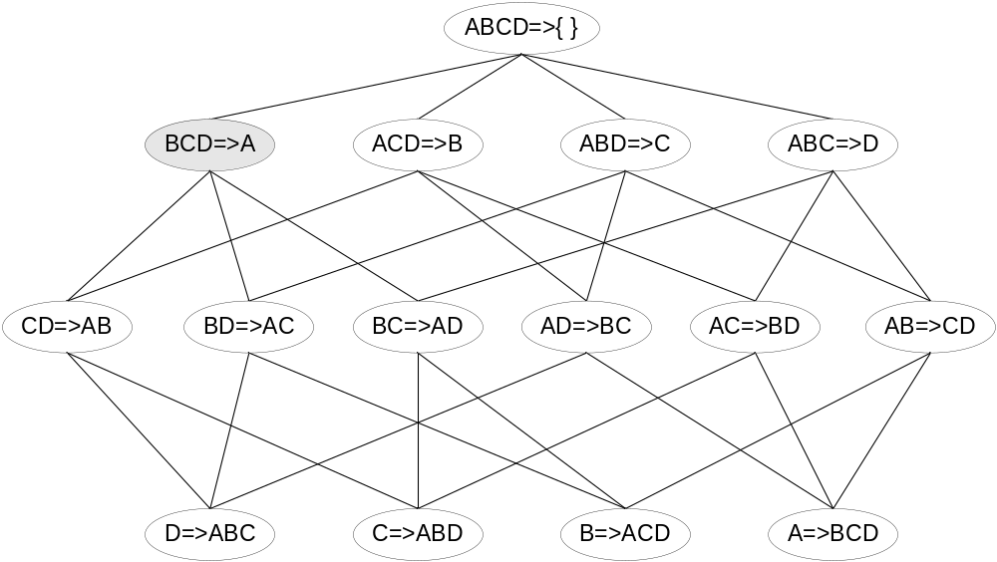

Rule Generation for Apriori Algorithm
Lattice of rules
Low Confidence Rule
Pruned Rules

Slide 33
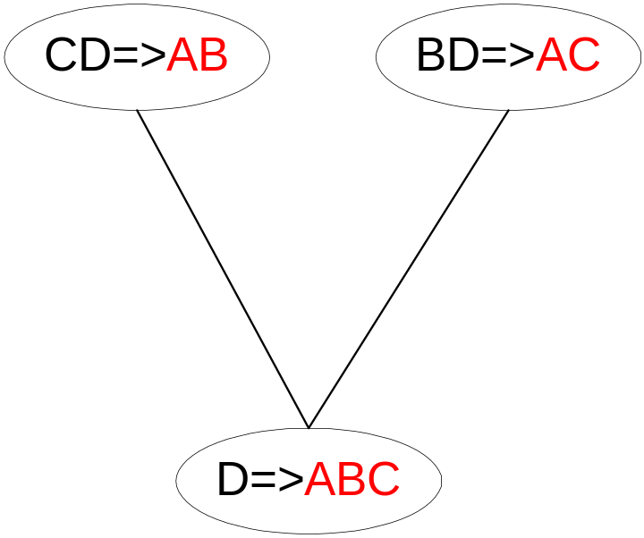
Rule Generation for Apriori Algorithm
Candidate rule is generated by merging two rules that share the same prefix
in the rule consequent
join(CD=>AB,BD=>AC)
would produce the candidate
rule D => ABC
Prune rule D=>ABC if its
subset AD=>BC does not have
high confidence

Slide 34
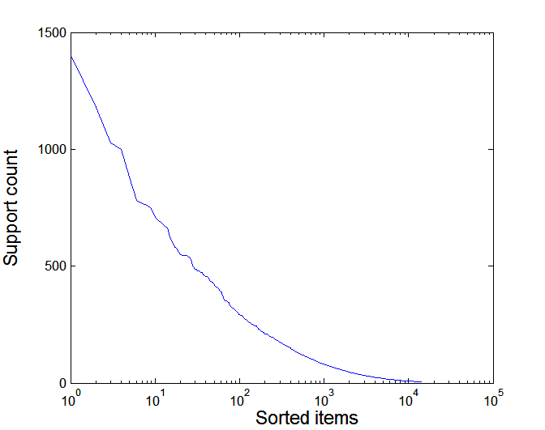
Effect of Support Distribution
Many real data sets have skewed support distribution
Support distribution of a retail data set

Slide 35
Effect of Support Distribution
How to set the appropriate minsup threshold?
  If minsup is set too high, we could miss itemsets involving interesting rare items (e.g., expensive products)
  If minsup is set too low, it is computationally expensive and the number of itemsets is very large
Using a single minimum support threshold may not be effective

Slide 36
Computing Interestingness Measure
The first set of criteria can be established through statistical arguments. Patterns that involve a set of mutually independent items or cover very few transactions are considered uninteresting because they may capture spurious relationships in the data. Such patterns can be eliminated by applying an objective interestingness measure that uses statistics derived from data to determine whether a pattern is interesting. Examples of objective interestingness measures include support, confidence, and correlation.

Slide 37
Computing Interestingness Measure
The second set of criteria can be established through subjective arguments.
A pattern is considered subjectively uninteresting unless it reveals unexpected information about the data or provides useful knowledge that can lead to profitable actions. For example, the rule {Butter} → {Bread} may not be interesting, despite having high support and confidence values, because the relationship represented by the rule may seem rather obvious. On the other hand, the rule {Diapers} −→ {Beer} is interesting because the relationship is quite unexpected and may suggest a new cross-selling opportunity for retailers.

Slide 38
Computing Interestingness Measure
Given a rule X → Y, information needed to compute rule interestingness can be obtained from a contingency table
Contingency table for X → Y
 | Y | Y
X | f₁₁ | f₁₀ | f₁₊
X | f₀₁ | f₀₀ | f_{o+}
 | f₊₁ | f₊₀ | |T|
f₁₁: support of X and Y
f₁₀: support of X and Y
f₀₁: support of X and Y
f₀₀: support of X and Y
Used to define various measures
support, confidence, lift, Gini,
J-measure, etc.

Slide 39
Computing Interestingness Measure
Given a rule X → Y, information needed to compute rule interestingness can be obtained from a contingency table
Contingency table for X → Y
 | Y | Y
X | f₁₁ | f₁₀ | f₁₊
X | f₀₁ | f₀₀ | f_{o+}
 | f₊₁ | f₊₀ | |T|
f₁₁: support of X and Y
f₁₀: support of X and Y
f₀₁: support of X and Y
f₀₀: support of X and Y
Used to define various measures
support, confidence, lift, Gini,
J-measure, etc.

Slide 40
Statistical Independence
Population of 1000 students
  600 students know how to swim (S)
  700 students know how to bike (B)
  420 students know how to swim and bike (S,B)
  P(S∧B) = 420/1000 = 0.42
  P(S) × P(B) = 0.6 × 0.7 = 0.42
I(S,B) = 1, if A and B are independent;
I(S,B) > 1, if A and B are positively correlated;
I(S,B) < 1, if A and B are negatively correlated.

Slide 41
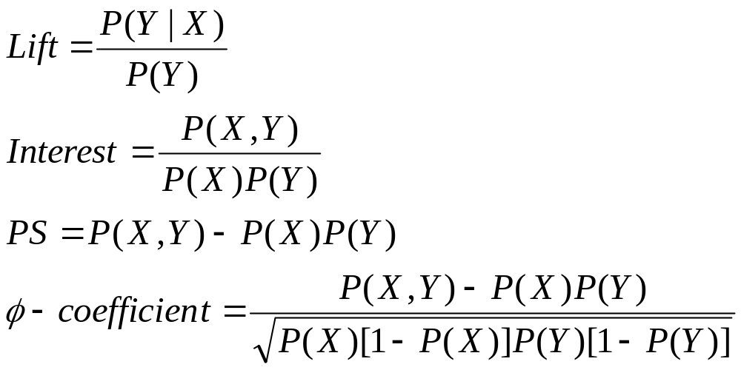
Statistical-based Measures
Measures that take into account statistical dependence
Notes:
Piatetsky-Shapiro (PS)

Slide 42
Example: Lift/Interest
 | Coffee | Coffee
Tea | 15 | 5 | 20
Tea | 75 | 5 | 80
 | 90 | 10 | 100
Association Rule: Tea → Coffee
Confidence= P(Coffee|Tea) = 0.75
but P(Coffee) = 0.9
Lift = 0.75/0.9= 0.8333 (< 1, therefore is negatively associated)

Slide 43
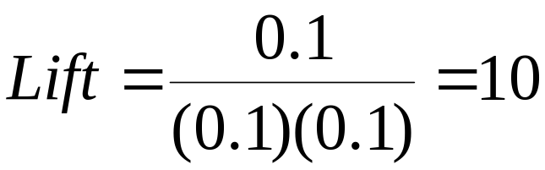
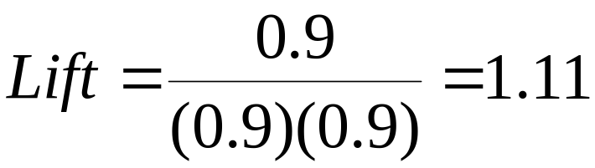
Drawback of Lift & Interest
 | Y | Y
X | 10 | 0 | 10
X | 0 | 90 | 90
 | 10 | 90 | 100
 | Y | Y
X | 90 | 0 | 90
X | 0 | 10 | 10
 | 90 | 10 | 100
Statistical independence:
If P(X,Y)=P(X)P(Y) => Lift = 1
Notes:
Lift/Interest loses its sensitivity when support of the itemset is very high

Slide 44
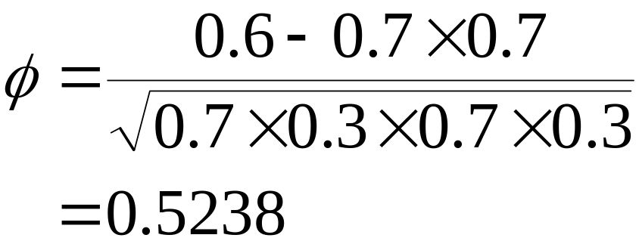
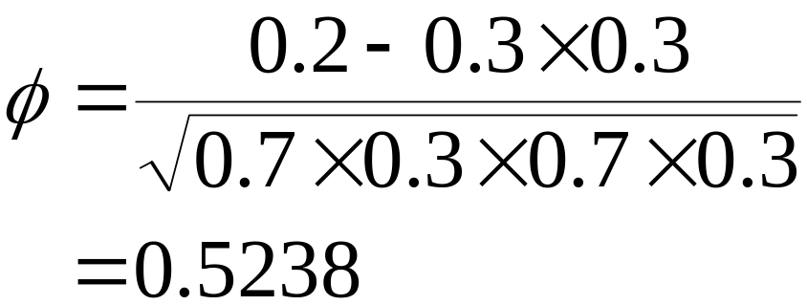
Example: φ-Coefficient
φ-coefficient is analogous to correlation coefficient for continuous variables
 | Y | Y
X | 60 | 10 | 70
X | 10 | 20 | 30
 | 70 | 30 | 100
 | Y | Y
X | 20 | 10 | 30
X | 10 | 60 | 70
 | 30 | 70 | 100
φ Coefficient is the same for both tables
Notes:
The value of correlation ranges from −1 (perfect negative correlation) to +1
(perfect positive correlation). If the variables are statistically independent,
This is because the φ-coefficient
gives equal importance to both co-presence and co-absence of items in a transaction.
It is therefore more suitable for analyzing symmetric binary variables.
Another limitation of this measure is that it does not remain invariant when
there are proportional changes to the sample size
then φ = 0. For

